Slide 1


Boston Azure Bootcamp
March 29th, 2014
Azure VMs, Websites
Udaiappa Ramachandran ( Udai )
@nhcloud

Slide 2
Who am I?
Udaiappa Ramachandran ( Udai )
Chief Architect, Ektron
Part-time Cloud Consultant
New Hampshire Cloud User Group (http://www.nashuaug.org )
Focus on Cloud Computing
  Windows Azure and Amazon Web Services
http://cloudycode.wordpress.com
@nhcloud

Slide 3
Windows Azure VMs

Slide 4
Agenda
Windows Azure VMs
VM and Cloud Services
VM Availability
Disks
Images
Managing VMs

Slide 5



  Windows Azure
  Your Datacenter
  Virtual Machines
  Cloud Services
  Web
  Sites
Applications
Applications
Applications
Applications
Data
Data
Data
Data
Firewall
Firewall Rules
Firewall Rules
Network
Virtual Network
Virtual Network
O/S
O/S
Virtualization
Hardware
Focus on the Application
Notes:
Slide Objectives:
Explain the differences between traditional self-hosting and the three options of Windows Azure hosting.
Notes:
In a traditional environment you must manage the full stack. With Windows Azure you can choose a variety of options depending on your needs.

Slide 6
Windows Azure Virtual Machines
  IT Pro experience
  Support for key server applications
  Easy storage manageability
  High availability features
  Advanced networking
  Integration with compute PaaS

Slide 7


Cloud First Provisioning
Getting Started
Select Image
and VM Size
New Disk Persisted in Storage
Windows Server
Management Portal
Boot VM from New Disk
Linux
>_
Extra Small
Small
Medium
Large
X-Large
Scripting
(Windows, Linux and Mac)
Cloud
REST API
Notes:
Slide Objective:
Explain workflow for provisioning VMs in the cloud
Notes:
Cloud First Provisioning means exactly what is says. Building a VM in the cloud first.
You have three methods of starting this process: Build a VM from the portal, from the command line OR programmatically calling the REST API.
Once your choice of provisioning is made you will need to select the image and instance size to start from.
The newly created disk will be stored in blob storage and your machine will boot.

Slide 8
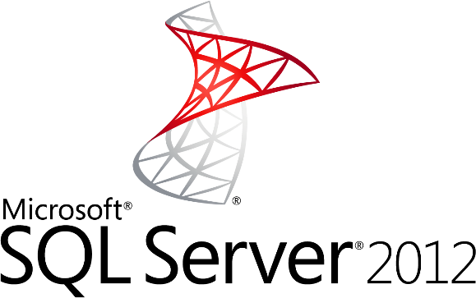
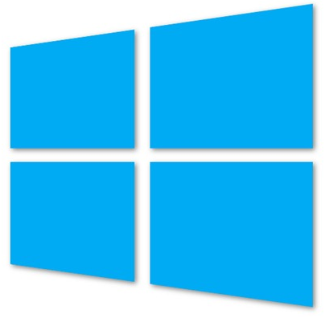
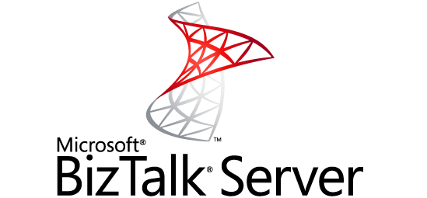
Gallery Images Available
Microsoft
Windows Server 2008 R2
SQL Server Eval 2012
Windows Server 2012
Biztalk Server 2013 Beta
Open Source
OpenSUSE 12.2
CentOS 6.3
Ubuntu 12.04/12.10
SUSE Linux Enterprise Server 11 SP2
Oracle

Slide 9
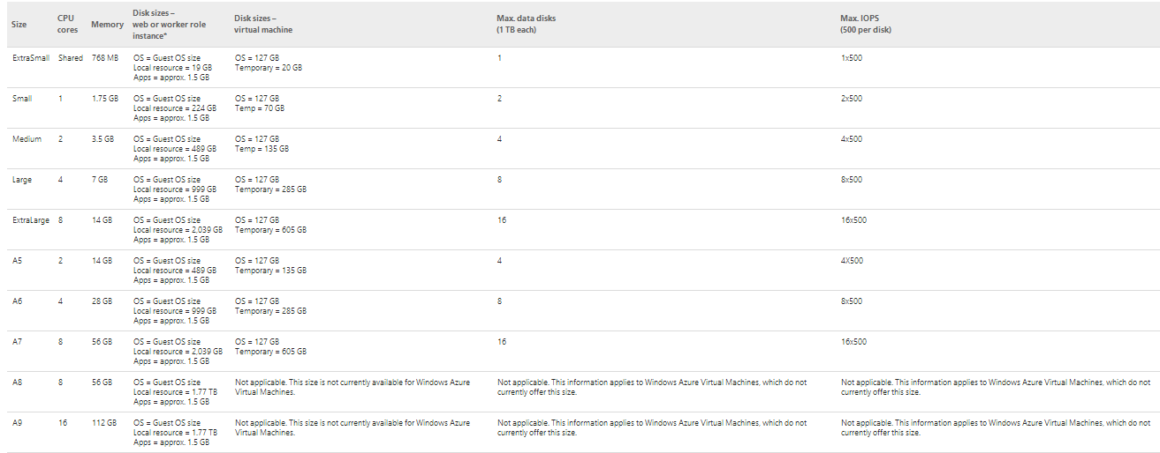
Virtual Machine Sizes
Each Persistent Data Disk Can be up to 1 TB
Notes:
Slide Objective:
VM sizes

Slide 10



Linux Offering
1ST
Open Source Community
Support
First Class Citizen
Enterprise + ISV
Notes:
Slide Objectives:
Provide a better understanding of Microsoft’s Linux offering on Windows Azure
Speaking Points:
1) Linux as a first class citizen in Azure
2) We will focus mainly on Enterprises and ISVs but will also reach out to the community
a) Open Sourcing critical components
b) Documenting API
3) We will offer both Community and Commercial Distributions
4) You will be able to buy support for the commercial distributions (GA only)
Transitions:
1) First Class Citizen
2) Enterprise + ISV
3) Open Source Community
4) Support
Notes:
Any notes go here

Slide 11
Virtual Machines and Cloud Services

Slide 12

Cloud Services, Roles, and Instances
WEB ROLE
Cloud Service is a…
Management
Configuration
Security
Networking
Service Model
boundary
VM 1
VM 2
VM 3
ROLES
INSTANCES
WORKER ROLE
VM 4
VM 5
VM…

Slide 13
Cloud Services with Virtual Machines
Multiple Virtual Machines can be hosted within the same cloud service
Cloud Service
VM 1
VM 2
VM 3
VM 4
Notes:
There are default limits in Azure as follows:
20 Hosted Service Projects
5 Storage Accounts
5 roles per Hosted Service (i.e. 3 different web roles + 2 different worker roles or any such combination)
20 CPU cores (not instances) across all your Hosted Service Projects
(http://blogs.msdn.com/b/jnak/archive/2010/01/22/windows-azure-instances-storage-limits.aspx)

Slide 14



Multiple Cloud Services Configuration
LB
WEB
AD/DC/DNS
SQL
AD 1
Cloud Service 2
80/443
VPN Tunnel
Corp Users
Cloud Service 1
Azure
OnPrem

Slide 15
Virtual Machine Availability

Slide 16

Service Level Agreements
Availability set
99.95% for multiple role instances
  4.38 hours of downtime per year
Server 1
Server 2
What’s included
  Compute Hardware failure (disk, cpu, memory)
  Datacenter failures - Network failure, power failure
  Hardware upgrades, Software maintenance – Host OS Updates
What is not included
  VM Container crashes, Guest OS Updates
SLA 99.95
Notes:
Slide Objective:
You need an availability set for a 99.95% SLA
Notes:
Without at least two virtual machines performing the same workload grouped into an availability set you get a 99.95% SLA.

Slide 17
Fault and Update Domains
Fault Domains
  Represent groups of resources anticipated to fail together
  i.e. Same rack, same server
  Fabric spreads instances across fault at least 2 fault domains
Update Domains
  Represents groups of resources that will be updated together
  Host OS updates honour service update domains
  Specified in service definition
  Default of 5 (up to 20)
Fabric spreads role instances across Update Domains and Fault Domains
Notes:
Slide Objective:
Discuss achieving very high availability with Windows Azure
Notes:
Fault Domain is a physical unit of failure, and is closely related to the physical infrastructure in the data centers.
In Windows Azure the rack can be considered a fault domain. However there is no 1:1 mapping between fault domain and rack.
Windows Azure Fabric is responsible to deploy the instances of your application in different fault domains.
Obviously this only applies if you run more than 1 instance
Right now Fabric makes sure that your application uses at least 2 (two) fault domains, however depending on capacity and VM availability it may happen that it is spread across more than that.
As a developer u have no direct control over how many fault domains your application will use but the way you configure it may impact your availability
Upgrade Domain is a logical unit, which determines how particular service will be upgraded.
The default number of upgrade domains that are configured for your application is 5 (five). You can control how many upgrade domains your application will use through the upgradeDomain configuration setting in your service definition file (CSDEF).
Windows Azure Fabric ensures that particular upgrade domain is not within single fault domain
That is Upgrade domains are orthogonal to fault domains
Roles are then spread out over upgrade domains and fault domains. Subject to running a reasonable number of instances this removes the risk of a single point of failure

Slide 18
Fault and Update Domains
Fault Domain
Fault Domain
Rack
Rack
Web Role
UD #1
UD #2
INSTANCE
INSTANCE
INSTANCE
INSTANCE
Worker Role
UD #1
UD #2
INSTANCE
INSTANCE
INSTANCE
INSTANCE
Notes:
Slide Objective:
Provide a graphical view of fault and upgrade domains for existing web and worker roles. Use to contrast existing skills with availability sets.
Notes:
You can see that our service is well spread out across both fault and upgrade domains
The loss of a fault domain will not cause a failure of our service nor will the restart or change of an upgrade domain cause a failure of our service
Notes
Useful pre-reading here.
http://blog.toddysm.com/2010/04/upgrade-domains-and-fault-domains-in-windows-azure.html

Slide 19
Virtual Machine Availability Sets
Update Domains are honored by host OS updates
Fault Domain
Fault Domain
Rack
Rack
Virtual Machine
Virtual Machine
Availability Set
IIS1
IIS2
UD #1
UD #2
Availability Set
Virtual Machine
Virtual Machine
SQL1
SQL2
UD #1
UD #2
Notes:
Slide Objective:
Explain availability sets
Notes:
Availability sets tell the Fabric Controller to place VMs in the same set on different racks for faults and in separate upgrade domains for updates.
This essentially tells the FC not to take the guest OS down of all VMs in the same set for host updates.

Slide 20

End to End Highly Available Solution
Redundancy at every level
SQL Server1
SQL-AVSET
Internet
IIS Web Application
IIS-AVSET
  Web Role
  SQL Mirroring
LB
IIS Web Application
SQL Server2
  Web Role
Notes:
Slide Objective:
Explain that each tier of an application can be enabled with its own availability set which ensures at a physical hardware level in the data center that there is no single point of failure.

Slide 21
Disks

Slide 22
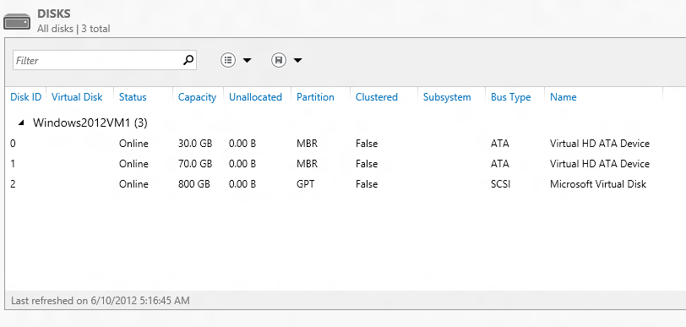
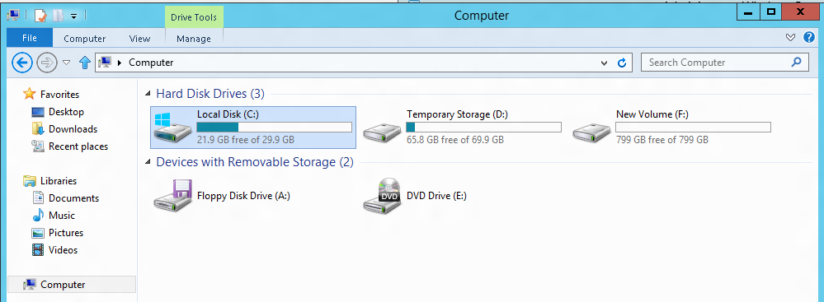
VM disk layout
OS Disk
Persistent
SATA
Drive C:

Slide 23
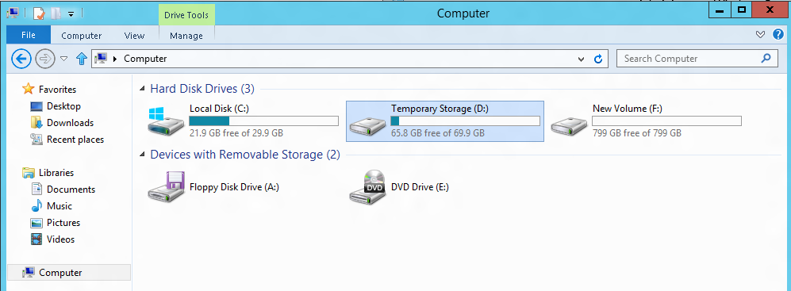
VM disk layout
Temporary Storage Disk
Local (Not Persistent)
SATA
Drive D:

Slide 24
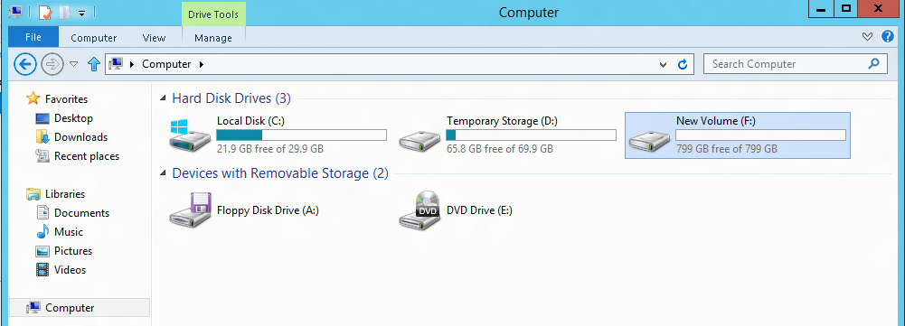
VM disk layout
Data Disk(s)
Persistent
SCSI
Customer Defined Letter

Slide 25
Persistent Disk Management
Capability | OS Disk | Data Disk
Host Cache Default | ReadWrite | None
Max Capacity | 127 GB | 1 TB
Imaging Capable | Yes | No
Hot Update | Cache Setting Requires Reboot | Change Cache Without Reboot, Add/Remove without Reboot.
C:\ = OS Disk
D:\ = Non-Persistent Cache Disk
E:\, F:\. G:\ ... Data Disks
Notes:
Slide Objective:
Highlight the differences in default cache policy between the OS disk and DataDisk

Slide 26
Disk Caching
Disk Type | Default | Supported
OS Disk | ReadWrite | Read-only and ReadWrite
Data Disk | None | None, Read-only and ReadWrite
Modify using Set-AzureOSDisk or Set-AzureDataDisk
Notes:
Slide Objective:
Data Disks can have caching enabled on up to 4 disks.

Slide 27

Persistent Disks and Highly Durable
Windows Azure Storage (Disaster Recovery)
Windows Azure Storage
Virtual Machine
Notes:
Slide Objective:
Explain how disks are durable and how Windows Azure storage works
Notes:
The OS and Data Disks are stored in Windows Azure storage. So in addition to the data being persistent you also get the benefits of storage which means your VHD is replicated 3X’s locally and also 3X’s in a separate data center in the same region (geo-replication)

Slide 28
Persistent Disks and Highly Durable
Windows Azure Storage (Disaster Recovery)
Windows Azure Storage
Virtual Machine
Virtual
Machine
Notes:
Slide Objective:
This slide simply highlights that if the physical hardware backing your VM goes down a new server will start and pick up the same VHD.

Slide 29
Images & Disks

Slide 30
Disks and Images
OS Images
Microsoft
Partner
User
Base OS image for new Virtual Machines
Sys-Prepped/Generalized/Read Only
Created by uploading or by capture
Disks
OS Disks
Data Disks
Writable Disks for Virtual Machines
Created during VM creation or during upload of existing VHDs.
Notes:
Slide Objective:
Explain the differences between disks and images with VMs

Slide 31
Image Mobility
On-Premises
Cloud
MyApp.vhd
Notes:
Slide Objective:
Explain the benefits of image mobility
Notes:
One of the key benefits of IaaS is flexibility and control. The Windows Azure solution provides the capability of not only moving VHDs TO the cloud but also allows you to copy the VHD back down and run it locally or on another cloud provider. Great for testing out production issues or any other need where you require a copy of the production server.

Slide 32
Bring Your Own Server/VHD
On-Premises
Cloud
MyApp.vhd
On Premises Virtual Server
Provision VM from Image or Disk using portal, script or API
Use Case
Forklift Migration of VMs
Sys Prepped Images
VHD Must Be Fixed Disk
* CSUpload Can Convert on Upload
Upload VHD
Create Disk or
Image
Notes:
Slide Objective:
Explain workflow for bringing your own VHD
Notes:
This use case is when you already have a “golden image(s)” your company uses for server provisioning or you have a VM running on premises that you would just like to run in our data center. You take the vhd – use CSUpload or System Center App Controller to upload as a page blob to a storage account. From there use the portal to add as an image (sysprepped) or disk (configured VM) and there you can create a VM based off of the vhd.

Slide 33
Imaging VMs in the Cloud
Cloud
Identical/similar deployment instances using common OS image as start
Base.VHD
Boot
VM
Customize
VHD
Generalize
VHD
Capture
VM
Capture VM Saves Customized Image to Your Image Library
Notes:
Slide Objective:
Explain workflow for creating a custom image in the cloud
Notes:
This use case is all about using the capture feature of IaaS to create OS images. The first part you start with a base vhd that you then custom with software binaries, registry settings etc.. You run sysprep.exe and generalize/shutdown the OS. You can then upload it if coming from on-premises or just click the capture button if you created the VM in the cloud.
Capture allows you to take a generalized VM and save the underlying VHD as a new image in your image library.

Slide 34
What will work on upload…
  Images
Sysprep’d Windows Server
VHD on Hyper-V
(Server 2008 R2 and Windows Server 2012)
Windows
Azure Image
Windows Server
VHD on Hyper-V
(Server 2008 R2 and Windows Server 2012)
Windows
Azure Disk
  Disks

Slide 35
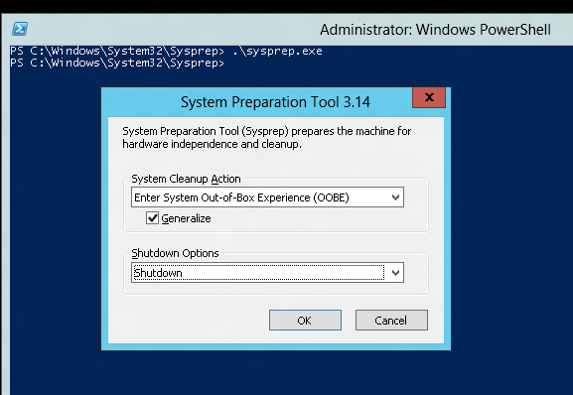
Tips on BYO Generalized Images
Sysprep and “Generalize” is expected
Do NOT put unattend.xml on the disk
Do NOT install the Windows Azure Integration Components!!
No WA Agent

Slide 36
Managing VMs

Slide 37



Manage using existing Tools
Windows Intune
Macs
X86/x64
AD
Windows Server 2012
Windows RT
VPN Tunnel
Windows Phone 8
iOS
Windows Server 2012
Windows Server 2008
Windows Server 2003
Windows Server 2008
Windows Server 2003
Android
OnPrem
Azure
Internet

Slide 38
Scripting Capabilities
Full Support for IaaS
Windows Azure PowerShell Cmdlets
Cross Platform Scripting Built on node.js
Capabilities
  Provisioning, Removal
  Reboot, Start
  Import and Export VM settings
  Support for Windows and Linux VMs
  Domain Join at Provision for Windows
  Fully Customize VM with Data Disks and Endpoint Configuration
  Automate Virtual Network Settings
Notes:
Slide Objective:
Highlight some of the functionality available to Windows Administrators to automate management / provisioning of virtual machines in the cloud.

Slide 39
What can you do with PowerShell?
Automation
Query, Manage and Configure Virtual Machines across multiple subscriptions,
cloud services and storage accounts.
Provision Fully Configured Virtual Machines
Domain Joined
Storage and Networking Configured
Virtual Networking
Completely Configure VNETs from a Script

Slide 40
Virtual Machine Management
Quick VM Provisioning Mode
Supports VM Creation in a Single Cmdlet
Advanced Provisioning Configuration Mode
Provision With: Endpoints, Data Disks
Configure: Cache Settings for OS/Data Disks and Subnet Names
Create Multiple Pre-Defined VMs in a Batch
New-AzureVM -VMs $vm1, $vm2, $vm3

Slide 41

Creating a Virtual Machine of your choice
Creating and attaching disk
Load balancing Virtual Machine
Creating SQL VMs
Creating Available set

Slide 42
Summary
  IT Pro experience
  Support for key workloads
  Create Disks and Images
  Manage VMs easily

Slide 43
Windows Azure Web Sites

Slide 44
  Windows Azure
  Your Datacenter
  Virtual Machines
  Cloud Services
  Web
  Sites
Applications
Applications
Applications
Applications
Data
Data
Data
Data
Firewall
Firewall Rules
Firewall Rules
Network
Virtual Network
Virtual Network
O/S
O/S
Virtualization
Hardware
Focus on the Application
Notes:
Slide Objectives:
Explain the differences between traditional self-hosting and the three options of Windows Azure hosting.
Notes:
In a traditional environment you must manage the full stack. With Windows Azure you can choose a variety of options depending on your needs.

Slide 45

Windows Azure Web Sites
powerful web sites in seconds
start simple
code smart
go live
start free, scale up and out as you go, friction-free and without the headaches
with classic asp, asp.net, php or node.js, develop on Windows, OSX or Linux
deploy live in seconds, easily monitor performance, rapidly diagnose and fix issues
Notes:
Slide Objectives:
Explain how Windows Azure websites are simple, easy, and open.
Notes:

Slide 46



Windows Azure Web Sites
start simple
code smart
go live

Slide 47
Start Simple
Get started with 10 free web sites
Create new sites in seconds
Easily manage and scale your sites
Automatic load balancing and shared storage across instances
Scale out or up to reserved instances for improved performance and scale

Slide 48
Code Smart
Use ASP.NET, ASP, PHP, or Node.js
SQL Azure or MySQL databases
Start with open source apps and frameworks
Develop with VS and WebMatrix
Supports any Web development tool on any platform (Windows, OSX, Linux)

Slide 49
Go Live
Rapid deployment for quick iteration
Integrated source control with Team Foundation Server (TFS) and Git
Built-in monitoring of perf and usage data
Quick access to request logs, failed requests diagnostics and diagnostics

Slide 50




Supported Web Frameworks
Or any custom FastCGI Handler
Notes:
Slide Objectives:
Explain that Windows Azure Web Sites supports Classic ASP, ASP.NET, PHP, and Node.js out of the box and that you can also host any custom FastCGI handler.
Notes:

Slide 51

Supported Publishing Methods
FTP://
TFS
WebDeploy
DropBox
Notes:
Git Deployment is Native, or through a Service hook from CodePlex, GitHub or BitBucket

Slide 52

scale
Free
Multi-tenant. Daily quotas
Shared
Multi-tenant. Daily quotas
Standard
Dedicated VMs. No quotas
Notes:
Slide Objectives:
Explain the three scale choices on Windows Azure Web Sites.
Notes:
Both free and shared are the same architecture. With standard you isolate your application to your own virtual machines that you can use and pay for whatever resources you choose.
Online Resources:
If you’d like more details on Web Site pricing and quota, see the Windows Azure pricing page here: http://www.windowsazure.com/en-us/pricing/details/web-sites/

Slide 53


web sites
shared
standard
1
shared
Shared instances
:-)
Notes:
Slide Objectives:
Explain how you can start with a small site hosted for free.
Notes:

Slide 54
web sites
shared
standard
2
shared
Shared instances
:-)
:-)
Notes:
Slide Objectives:
Explain how you can scale your site to multiple shared instances.
Notes:

Slide 55

web sites
shared
standard
1
0
standard
Shared instances
Standard instance
:-)
:-)
:-)
Notes:
Slide Objectives:
Explain how you can move to standard instances for additional scale.
Notes:

Slide 56
web sites
shared
standard
2
standard
Standard instance
Standard instance
:-)
:-)
Notes:
Slide Objectives:
Explain how you can scale up standard instances to multiple instances as needed.
Notes:

Slide 57


web sites
shared
standard
2
standard
Standard instance
Standard instance
:-)
:-)
:-)
:-)
:-)
:-)
:-)
:-)
Notes:
Slide Objectives:
Explain how you can host multiple sites that you own on a your standard instances.
Notes:

Slide 58
auto-scaling
standard
cpu utilization
Standard instance
Standard instance
Standard instance
:-)
:-)
:-)
Notes:
Slide Objectives:
Explain how you can host multiple sites that you own on a your standard instances.
Notes:

Slide 59
Diagnostics & Monitoring
HTTP Logs
Error Logs
Portal Monitoring
Log Streaming
New Relic
Notes:
Git Deployment is Native, or through a Service hook from CodePlex, GitHub or BitBucket

Slide 60
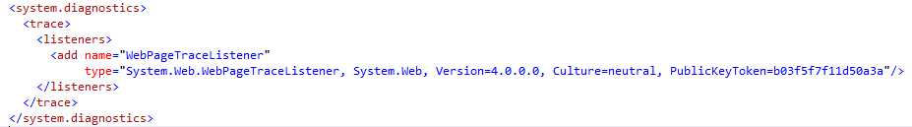
Logging and Monitoring
Turn on diagnostics logging from the portal
Use the System.Diagnostics.Trace
Configure System.Diagnostics in web.config
Azure commandlet Get-Azurewebsitelog
Changes made inside portal is not written to config file

Slide 61
Load Balancer and Routing
Load Blancer
  Windows Azure LB
  IIS LB + ARR
ARR(application reverse routing)
  reverse proxy
  verifies hosting database (plan, quotas,...)
  negotiates best node to run your site on
  site not used much? put it on a highly loaded machine

Slide 62
Web Servers
%system32%\inetsr\config\applicationHost.config is taken out of the loop
  Sql databases
  no refreshing of all app pools when file is saved
Storage
  "file share" hosted on other machines
  using "WA drive" on blob storage
Dynamic website activation
  verifies runtime database (plan, quotas,...)
  site not used for a while? Remove it from the server

Slide 63
Cold Site (1st Request)
Azure
LB
1
IIS ARR (LB)
3
WEB WORKER
2
Runtime DB
Other DB
4
5
5
STORAGE CONTROLLER

Slide 64
Hot Site (Nth Request)
Azure
LB
1
IIS ARR (LB)
2
WEB WORKER
3
3
Other DB
3
3
STORAGE CONTROLLER

Slide 65
Webjobs
Background Process
Triggered or continuous running
Accepted file types
  exe - .NET assemblies compiled with the WebJobs SDK
  cmd, .bat, .exe (using windows cmd)
  sh (using bash)
  php (using php)
  py (using python)
  js (using node)
Jobs will be deployed and managed thru portal

Slide 66





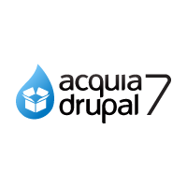










Windows Azure Web App Gallery
Ready-to-Go Open Source
Web Applications,
Frameworks,
and Templates
Notes:
Slide Objectives:
Highlight the ability to get started quickly with the Windows Azure Web App Gallery
Speaking Points:
Along-side the publishing capabilities, Windows Azure Web Sites also offers the Web App Gallery which provides many turn key solutions based off of well known open source web applications.
Notes:

Slide 67
Takeaways
Start Simple, Code Smart, Go Live
HTTPS is not supported
Custom domain configuration required shared or dedicated
Easy to integrate with other cloud components
Easy deployment using FTP, GIT, WEBDeploy or TFS
Websites are not in IIS they are only when request come in
You can provision staging environment using source control branch
Using .deployment file you can deploy one project from collection of web projects
You can run unit test by running your own Kudu service

Slide 68
Application Scenarios
Web Sites
Cloud Services
Virtual Machines
Modern web apps
Perfect if your app consists of client side markup and scripting, server side scripting and a database. Powerful capability to scale out and up as needed.
Multi-tier applications
Cloud-based applications that separate application logic into multiple tiers (i.e. caching middle tier, asynchronous background processes like order processing) using both Web and Worker Roles
Enterprise server applications
Run your existing enterprise applications in the cloud, such as SQL Server, SharePoint Server or Active Directory.
Continuous development
Deploy directly from your source code repository, using Git or Team Foundation Service.
Apps that require advanced administration
Cloud-based applications that require admin access, remote desktop access or elevated permissions
Porting existing line of business apps
Choose an image from the library or upload your own VHD.
Popular open source apps
Launch a professional looking site with a few clicks using apps like WordPress, Joomla!, Drupal, DotNetNuke and Umbraco
Apps that require advanced networking
Cloud-based applications that require network isolation for use with Windows Azure Connect or Windows Azure Virtual Network
Windows or Linux operating system
Support for Windows Server, along with community and commercial versions of Linux. Connect virtual machines with cloud services to take full advantage of PaaS services.

Slide 69
Creating web sites using Azure Portal
Deploying websites using
  FTP Deploy
  Web deploy
  Git
  TFS
  Creating SQL Databases and connecting thru apps
  Node JS
WebJobs
Windows Azure AD
http://www.asp.net/aspnet/overview/developing-apps-with-windows-azure/getting-started-with-windows-azure-webjobs
http://cloudbyte.blob.core.windows.net/blog/boston_azure_bootcamp_websites.pptx
http://cloudbyte.blob.core.windows.net/blog/boston_azure_bootcamp_websites_hol.docx

Slide 70
References
http://www.microsoft.com/hosting/en/us/services.aspx
http://channel9.msdn.com/Events/windowsazure/Windows-AzureConf-2013/Windows-Azure-Web-Sites-Things-They-Don-t-Teach-Kids-in-School
http://www.asp.net/aspnet/overview/developing-apps-with-windows-azure/getting-started-with-windows-azure-webjobs

Slide 71
Thank you for attending Boston Azure Bootcamp @ BlueMetal

